Slide 1
xAI with Signal Processing Attacks on Automatic Speech Recognition
By: Andrew Nguyen

Slide 2
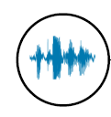
Neural Networks in audio is mostly used in Automatic Speech Recognition (ASR)
  Used in many IOT applications that have access to critical applications, such as paying via Amazon Alexa, making ASRs a prime target to attackers.
Black-Box, Maybe Grey-box access
White Box Access
Neural Network
Audio Samples
Feature Extraction
“house”
“how”
Mel-Frequency Cepstrum Co.
End-to-end Audio sample reading
Spectrogram Superpixels
RNN
Hidden Markov – Gauss
DNN
Notes:
End-end

Slide 3
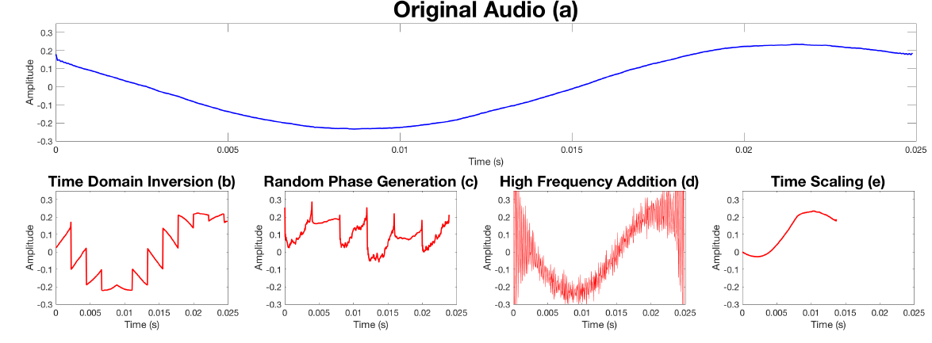

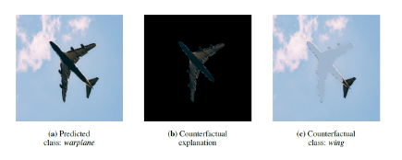
Relevant Work
  Overview of Attack Works
  Types of Attacks to transmit hidden message
  Signal Processing(SP) [1]: Abusing feature-engineering to generate hidden messages within human-interpreted “noise” (not simply WGN).
  Adversarial Examples[5]: Optimization-based reconstruction of hidden messages added into other audio signals.
Signal Processing: Original signal(Blue), different attacks(Red) [1]
Adversarial Example: Original signal(Blue), Perturbed signal (Orange) [5]
  Explainable AI [4]
  LIME in Audio
  Counterfactuals in Image Domain
Counterfactuals: Critical minimum portion to classify as warplane in image b[4]
Notes:
SP: Less than 15 queries with black box access
AE: thousand of queries with black box access, at least one hour per sample
“Pixels that should be minimally present for the original classification” and “Pixels that should be minimally absent for another classification”

Slide 4
Project Outline
Grey-box access to Mozilla’s state-of-the-art DeepSpeech [3] ASR
Generate and tinker with successful SP attacks on system
Find critical features in feature extraction that can explain the success of the attacks.
Notes:
greybox – public small knowledge of the feature extraction method used by Mozilla Deepspeech that they use overlapping spectrogram as inputs to NN

Slide 5
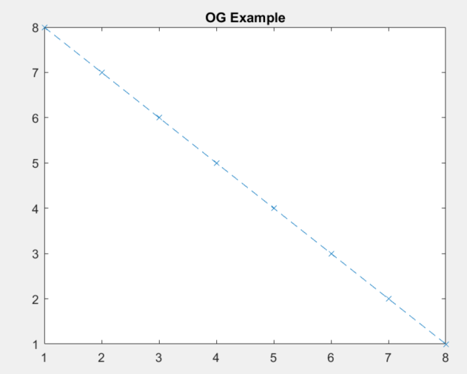
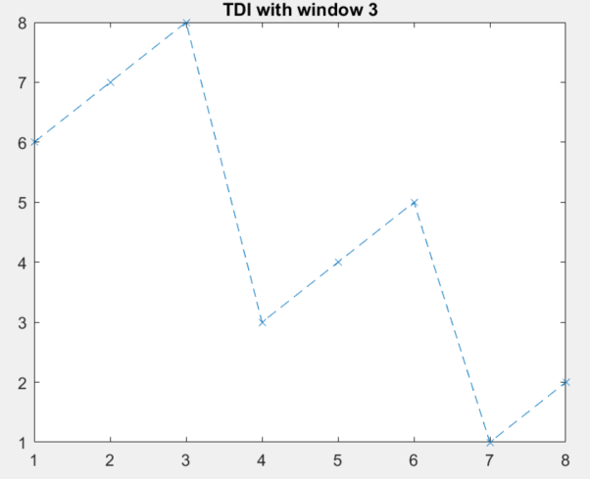

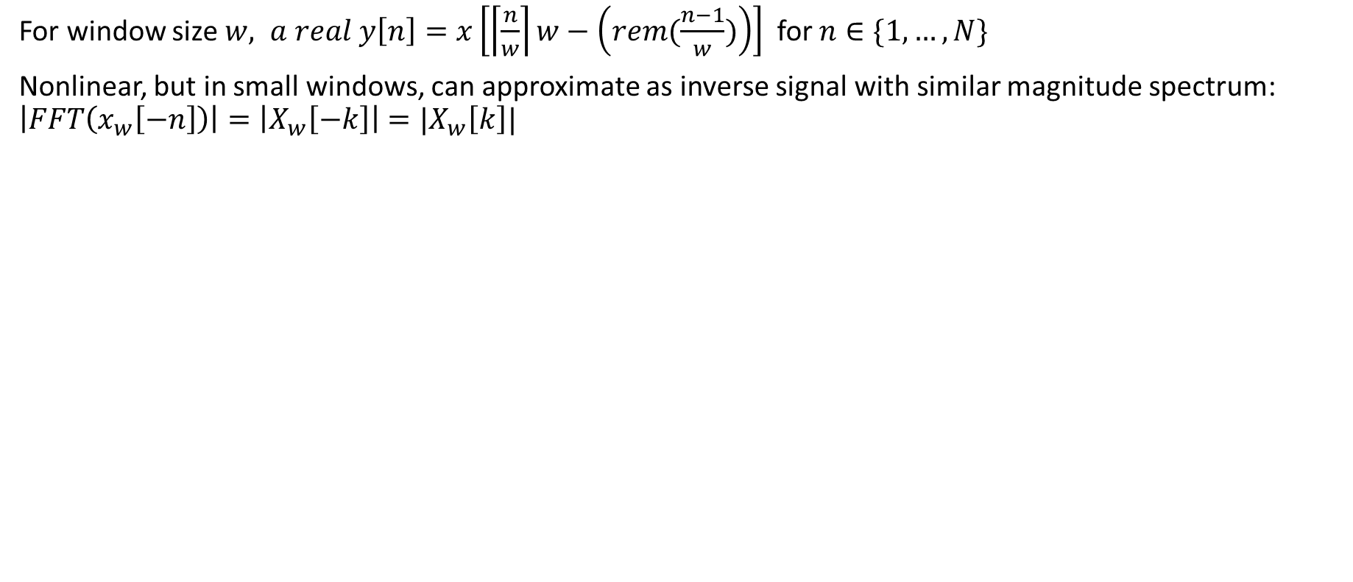
Signal Processing Attack Algorithm – TDI
For window size $w, a real y\left[n\right]=x\left[\left\lceil \frac{n}{w}\right\rceil w−\left(rem(\frac{n−1}{w})\right)\right]$ for $n∈\{1,…,N\}$
Nonlinear, but in small windows, can approximate as inverse signal with similar magnitude spectrum: $\left|FFT\left(x_{w}\left[−n\right]\right)\right|=\left|X_{w}\left[−k\right]\right|=|X_{w}\left[k\right]|$
TDI Signal Ex:
Original: Ex
Simple TDI Example

Slide 6
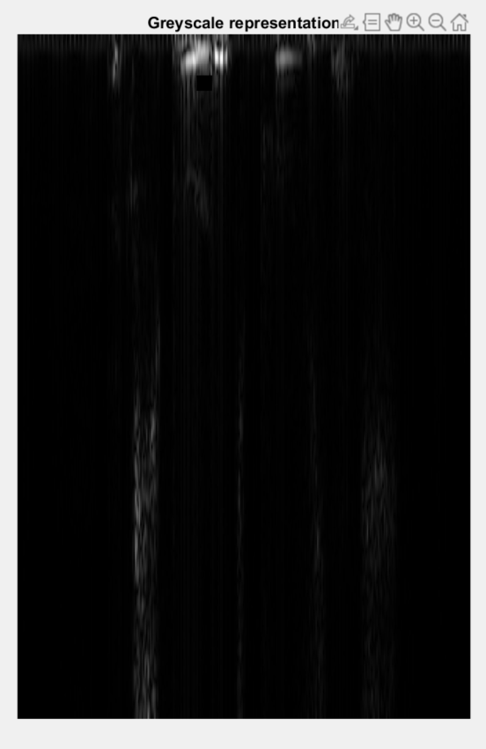
xAI Algorithm – SEDC for Speech Recognition
Extend Search for EviDence Counterfactual for Image Classification[8] into ASR domain.
SEDC for ASR
Define Short-time Fourier transform(STFT) hyperparameters: Window, Overlap, FFT Length etc.
Compute STFT of audio signal that outputs as a matrix. Define this as a “complex image” (an array containing complex values)
Segment images using some image segmentation (Square for simplicity)
For each segment, remove/add segment(as if signal didn’t/did have it). Apply real filter on inverse STFT to retrieve audio. If class change from the adjustment, append segment to “explainable” segments
If none is selected, find the “best explainable” based on confidence of model. Do step 2, but the segment is now defined as the “best” + a different segment (to find the best 2 explainable segment. Can be extended to more segments if needed).
“Explainable” Segment
Classification +
Confidence Score
Deepspeech query
Others
Example of Segment Removal
Append top few
Notes:
The goal is finding
Adversarial perturbation vs this? This is segments. In others it would be individual pixels changing ever so slightly, here its larger segments.

Slide 7
Experiment
As in [1], a few short (~1s) phrases were selected.
Over-the-line transmission due to hardware constraints
Attack audios generated varying window-size, picked most audibly distorted (also happened to be lowest window size) audio that was decoded properly.
Informal experimentation of psychoacoustics: new bystanders asked to guess output. People who know the phrase also tried to listen.
Ran SEDC for audio algorithm on attack audio and found “explainable” segments.

Slide 8
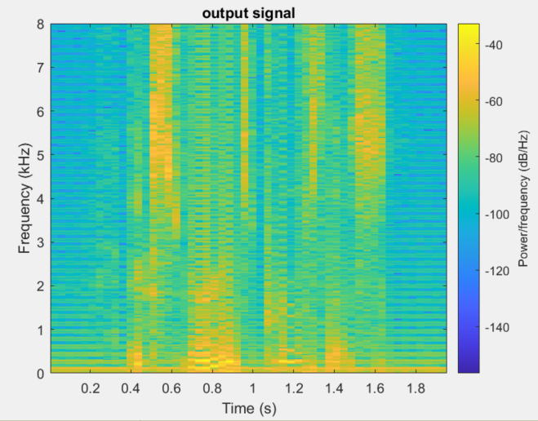
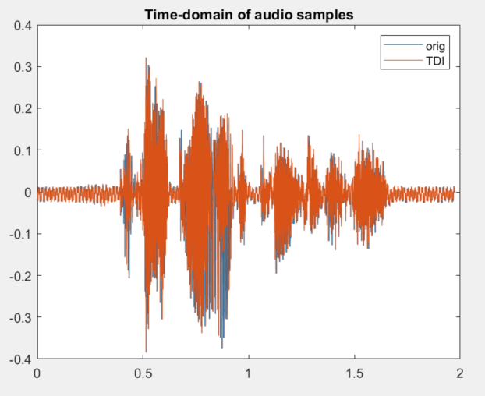
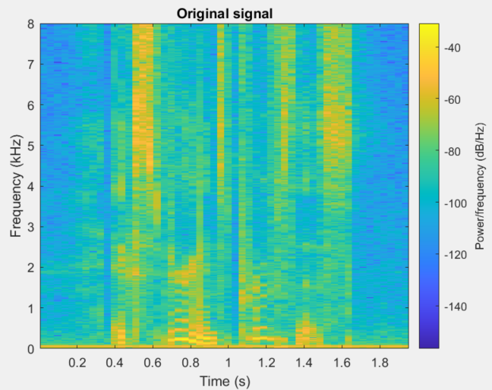
Experimental Results - Attack
TDI Signal Ex:
A couple manipulated phrases were experimented through model and on bystanders
Accuracy: Perfect Transcription (barring misspells)
[1]: Claim: All window size greater than minimum are successfully transcribed
  To a point. Greater distortion for humans and machine at lower window size. As you increase it, humans can easily decipher the message but the machine deciphers wrong. Why?
Original: Ex
dB Spectrogram before and after TDI Attack: Both classify the same
Notes:
Audio sample indeed came out very distorted and crunchy. Making it difficult for human observers to listen at times. The ML for some difficult audio couldn’t decode it. Converseley, humans could decipher message in the noise if they are attentive when ML could not. Spectrogram agrees that the spectrum is not exactly the same, our inversion windowed assumption has its limitations (unknown window size, estimate of around 20 ms). Manually observing similar positions just with increased artefacts within.

Slide 9
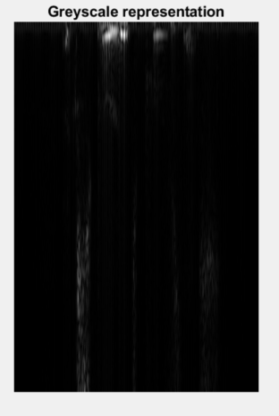
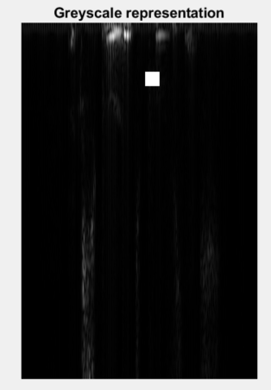
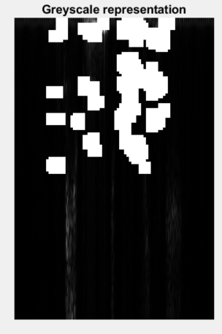
Experimental Results
Middle: Human can somewhat make out the words if they are listening,
but model classifies incorrectly
Utilized 20x20 spectrogram bin was the super pixel. Only had time to look for pertinent positive (minimally required for the audio to work)
Original: Experience Proves This
Middle: Experience Perishes
Other single segment effect:
Experience Proves
Experience Proves that
Left: Greyscale representation. Middle: One explainable segment Right: All one-segment size explainable segment
Notes:
5.76 ms TDI

Slide 10
Future Direction and Conclusion
Adversarial perturbation + other SP attacks ( High frequency, Random Phase)
Additional SP attacks beyond windowed FFT: i.e. stft poisoning
Original work citing magnitude spectrum is all that is needed no longer worked based on the experiment with Mozilla DeepSpeech: i.e. phase distortion can altered to a point
Over-the-Air using speaker and microphone system
Pertinent positive explain segments that need to be in the data to successfully classify. Absence of such is an attack that causes model to misidentify and human may still be able to hear
Pertinent negatives should be explored as absence is minimally required to successfully transcribe. How much magnitude and phase to add?
All others are Pertinent neutral. The segments contained or absent aren’t critical in the operation can be tinkered to distort human perception and successful transcription.
How does phase within the pertinent area effect outcome?
Different segmentation: spectrogram data pattern is not square shape. More complex segmentation can be accomplished as well. Larger segmentation size will improve time complexity (~4 hours on my laptop). A lot of null-segment(shown in black) that can be ignored for future. Or quantization on STFT a bit to ignore small changes or large batches of low-impact segments.
Experiment provided preliminary algorithm to developing xAI in audio domain.
Notes:
In Pertinent, say how the TDI attack slightly altered spectrogram data. Still contained and barely altered the pertinent positives needed for successful classification. Attack did not add any pertinent negatives and mainly changed pertinent neutral.

Slide 11
References
[1] H. Abdullah, W. Garcia, C. Peeters, P. Traynor, K. Butler, and J. Wilson, “Practical Hidden Voice Attacks against Speech and Speaker Recognition Systems,” Proceedings of the 2019 Network and Distributed System Security Symposium (NDSS), 2019.
[2] H. Abdullah, K. Warren, V. Bindschaedler, N. Papernot, and P. Traynor, “ SoK: The Faults in our ASRs: An Overview of Attacks against Automatic Speech Recognition and Speaker Identification Systems”, 2020.
[3] “Deep Speech 0.9.3,” Last accessed in 2022, available at https://github.com/mozilla/DeepSpeech/releases/tag/v0.9.3
[4] P. Gohel, P. Singh, M. Mohanty, “ Explainable AI: current status and future directions”, 2021
[5] N. Carlini and D. Wagner, “Audio adversarial examples: Targeted attacks on speech-to-text,” in 2018 IEEE Security and Privacy Workshops (SPW). IEEE, 2018, pp. 1–7.
[6] https://christophm.github.io/interpretable-ml-book/counterfactual.html
[7]A. Stojanow and J. Liebetrau, "A review on conventional psychoacoustic evaluation tools, methods and algorithms," 2016 Eighth International Conference on Quality of Multimedia Experience (QoMEX), 2016, pp. 1-6, doi: 10.1109/QoMEX.2016.7498923
[8] https://arxiv.org/pdf/2004.07511.pdf
[9] https://opus.bibliothek.uni-augsburg.de/opus4/frontdoor/deliver/index/docId/78731/file/Weitz2021_Article_LetMeExplainExploringThePotent.pdf

